Slide 1

Heartbeat Analysis
Classifying Heartbeat Anomalies from Stethoscope Data
Carlos Rocha, Mitsu Mehta, Rohan Shiroor

Slide 2
Agenda
Motivation
Problem Description
Dataset
Preprocessing of Data
Core Algorithm
Fine Tuning of Core Algorithm
Other Candidate Algorithm
Performance Comparison
Conclusion and Future Work

Slide 3
Motivation
Analysis of Human heartbeat for early detection of anomalies:
Heart disease is diagnosed through signs and symptoms presented by the patient, through a routine checkup or prior to a surgical procedure. However, if the patient never goes to see a medical doctor the disease may never be discovered. On the other hand, this process can be started if the patient has access to some tool that can detect anomalies and produce a warning advising the patient to visit a heart specialist.

Slide 4
Problem Description
Analysis of heartbeat dataset for early detection of abnormal heartbeats over the data collected from clinical research and mobile devices.

Slide 5
Dataset
Data retrieved from: Kaggle.com
832 Audio (WAV) Files
Class Labels:
Normal
Murmur
Extra heart sound (extrahls)
Artifact
Extrasystole.

Slide 6
Pre-Processing of Data
Removal of Unlabeled Data
247 rows are unlabeled.
Since we do not have the domain expertise, we cannot label the unlabeled data.
Hence, the unlabeled data is removed.
The rest 585 rows are used for testing and training our model.

Slide 7
Standard Procedure
Normally medical doctors look for lub and dub sounds
Normal Category
…lub……….dub……………. lub……….dub……………. lub……….dub……………. Lub……….dub…
Murmur Category
…lub..*...dub……………. lub..*..dub ……………. lub..*..dub ……………. lub..*..dub …
…lub……….dub…*….lub………. dub…*….lub ………. dub…**….lub ……….dub…

Slide 8
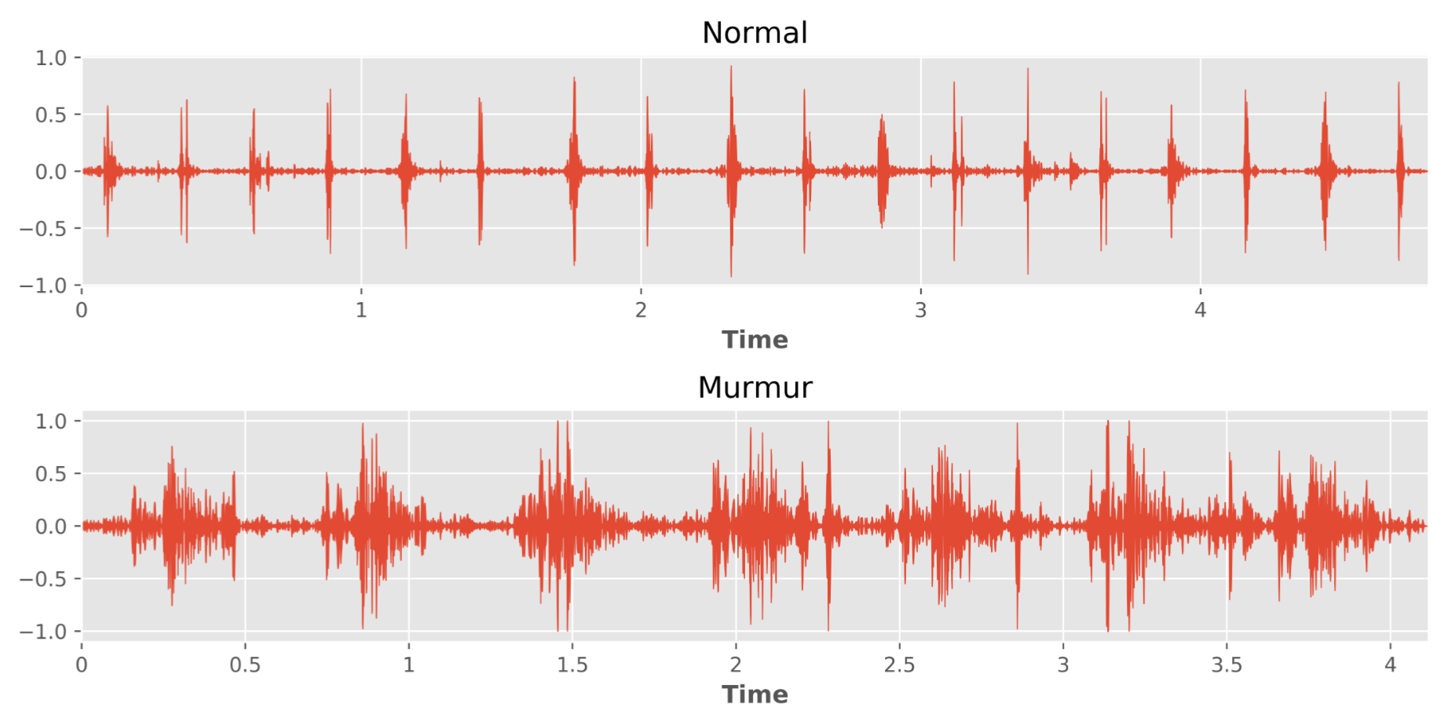
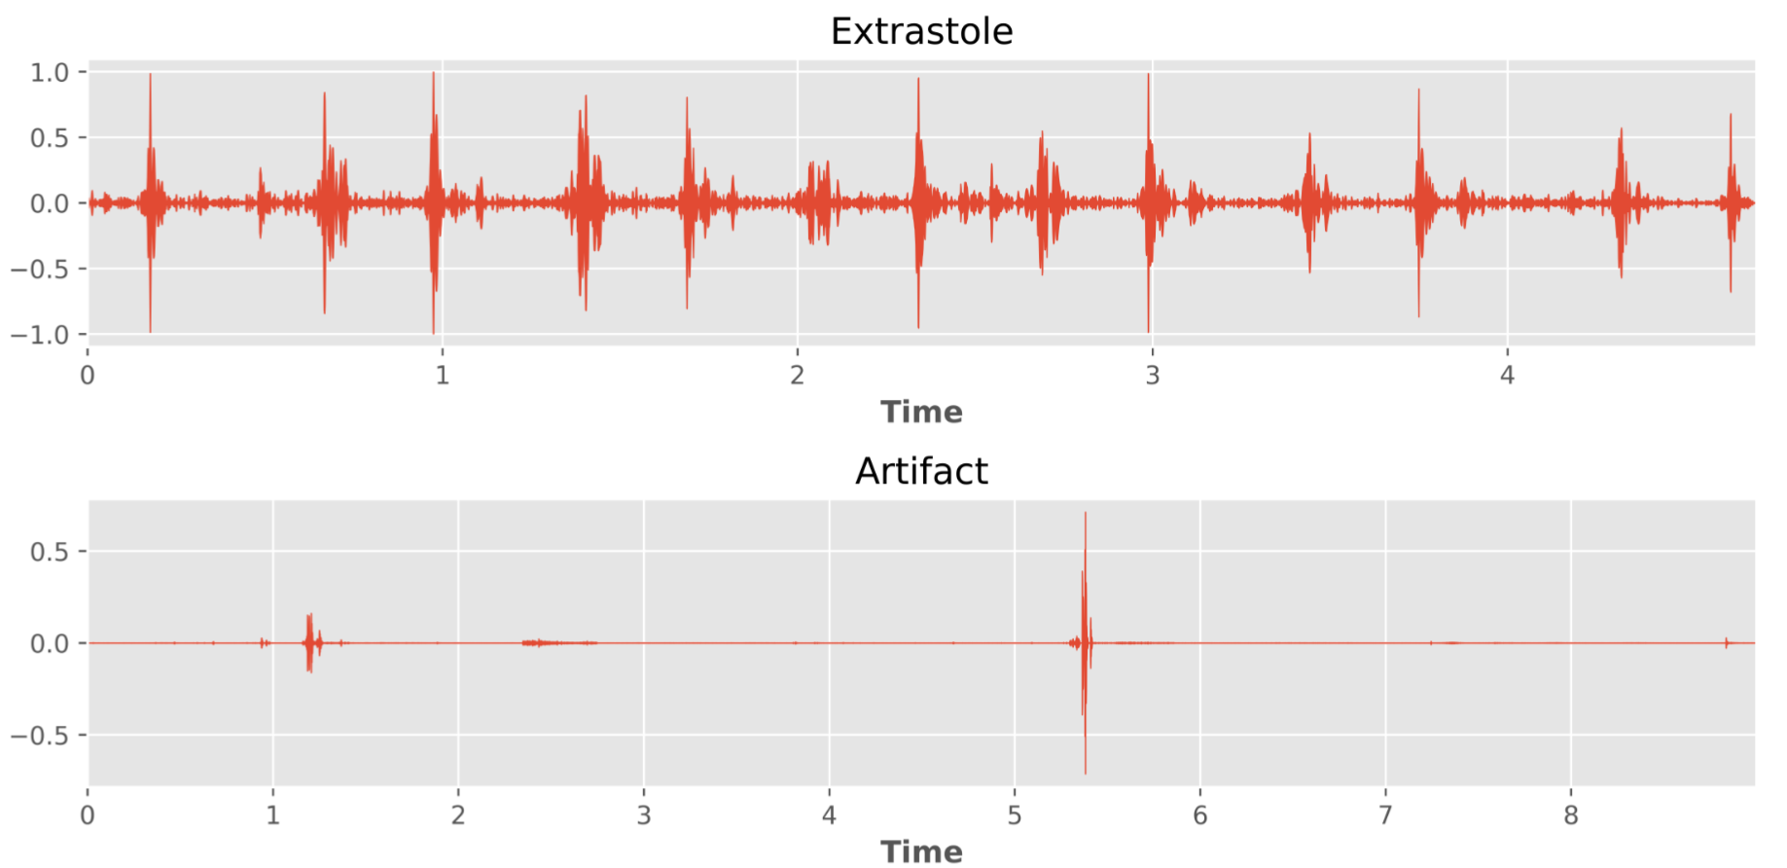
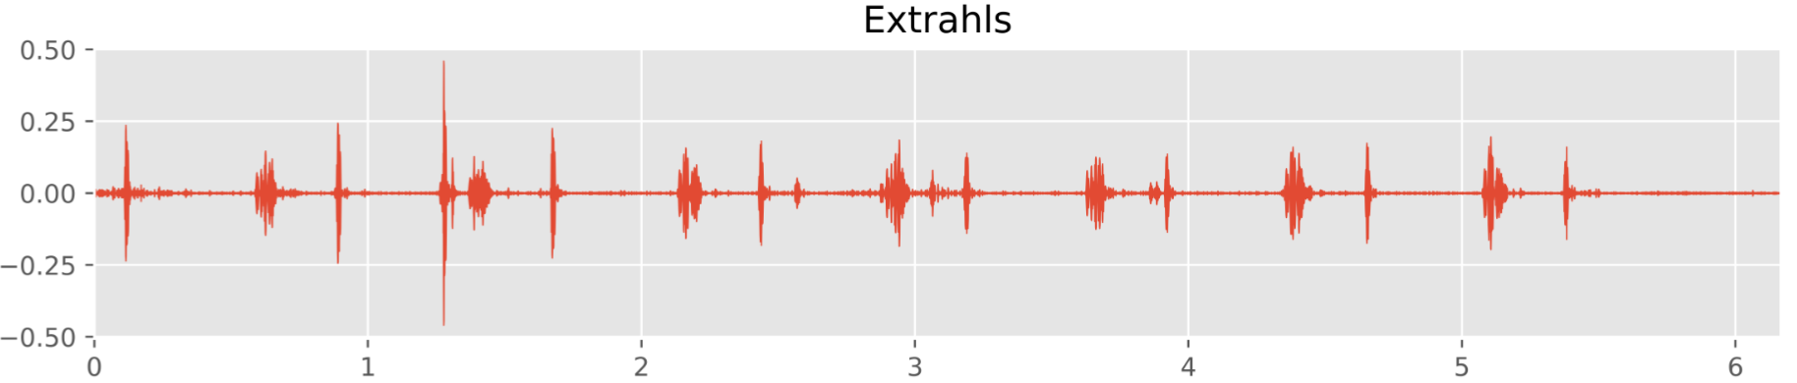
Wave Plots

Slide 9
Pre-Processing of Data
Feature Extraction from Audio Files
We have used Librosa library in Python to extract numeric features from audio files retrieved in .wav format.
6 features extracted from audio files.
Each feature is a vector, therefore total features = 577

Slide 10
Issues with raw data
Sampling Rate: 44.1 kHz = 44100 samples per second
Different recording time: some files are longer than others

Slide 11
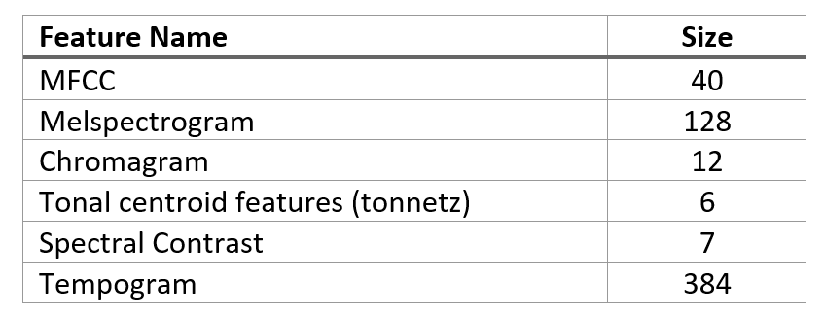
Extracted Features
These features represent the spectral and temporal characteristics of audio

Slide 12
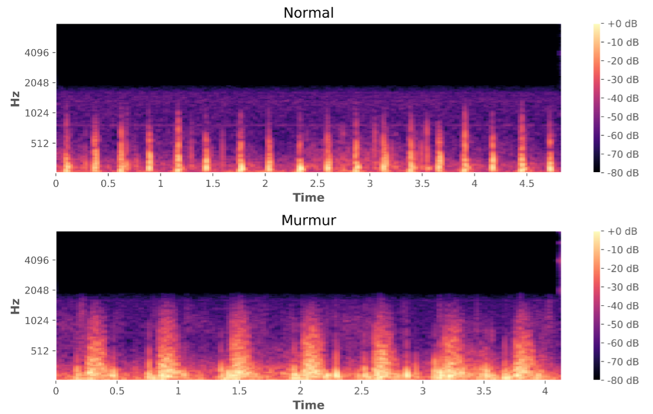
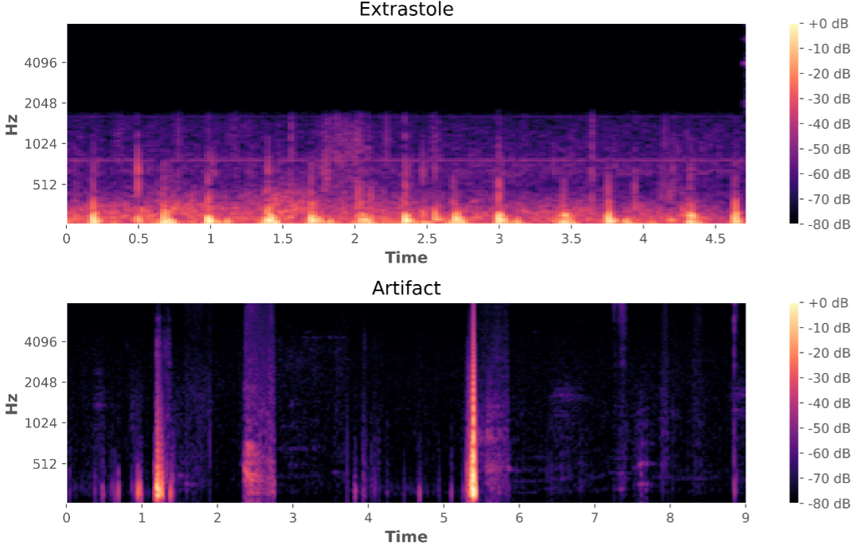
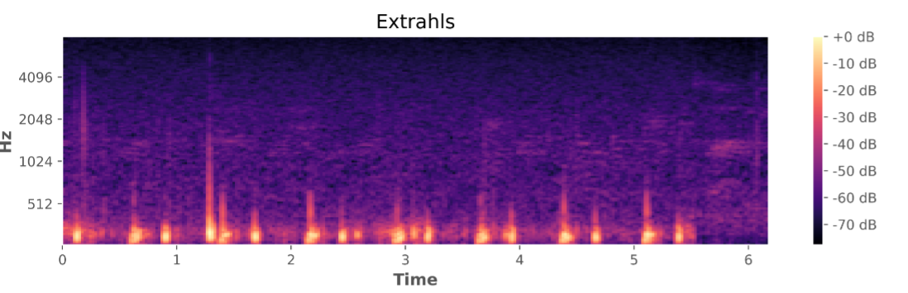
Mel-scaled Spectrograms
The power spectrum of a time series describes the distribution of power into frequency components composing that signal.

Slide 13
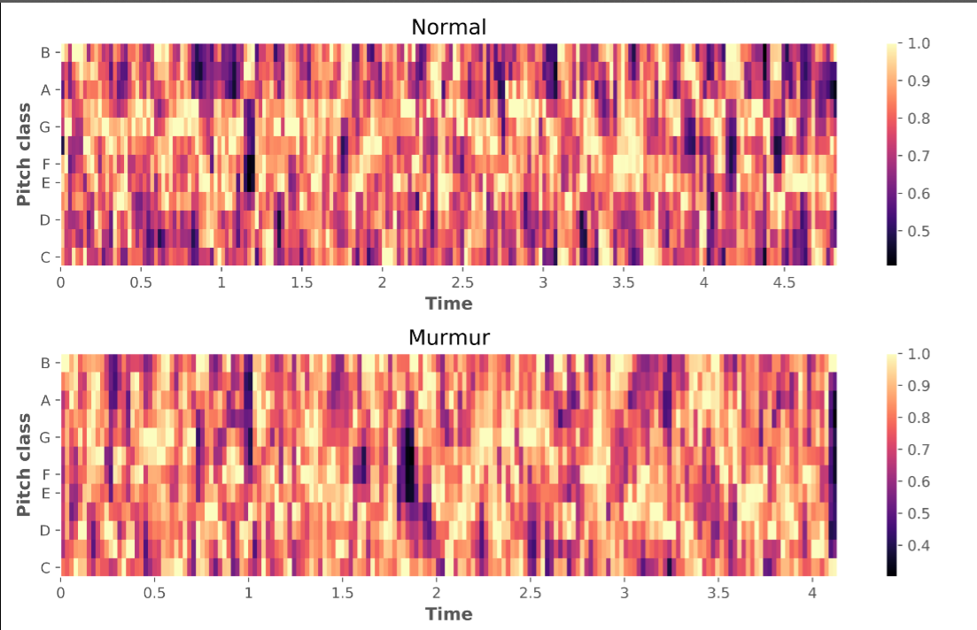
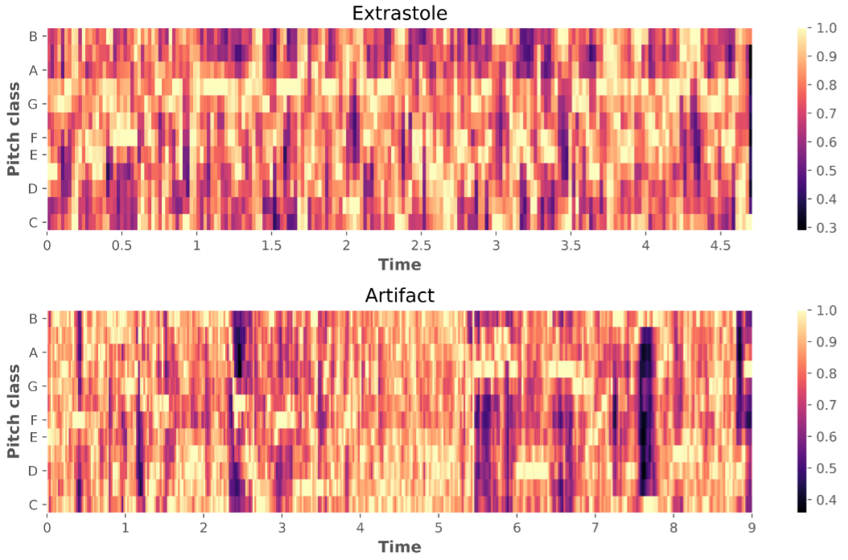
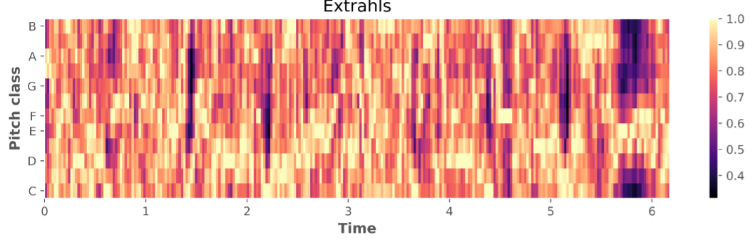
Chromagrams

Slide 14
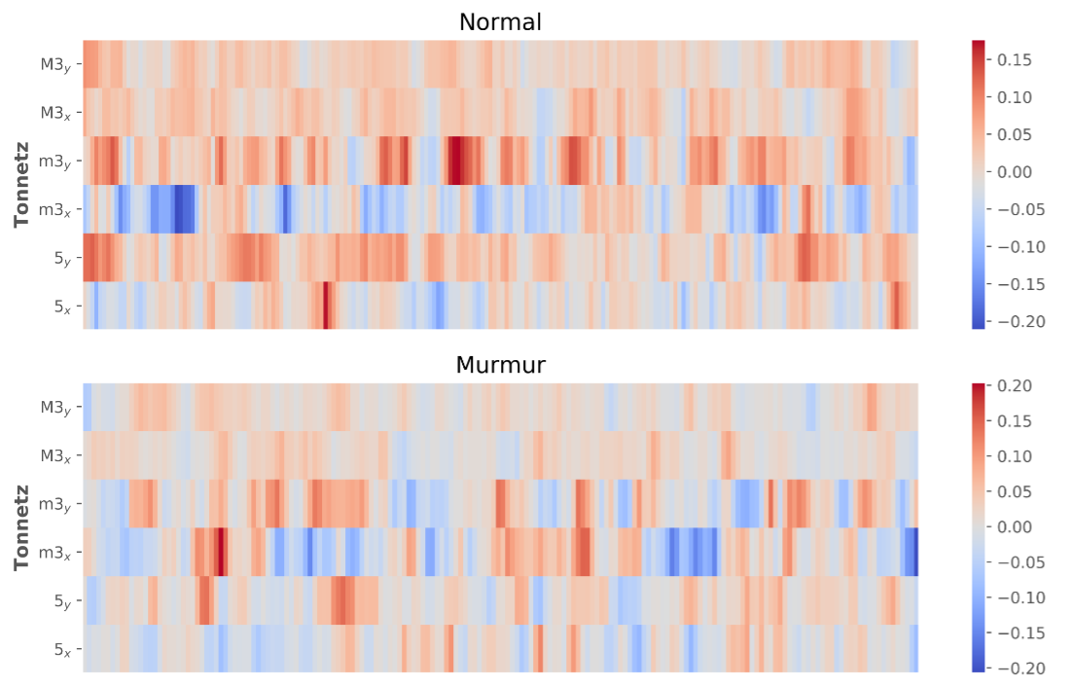
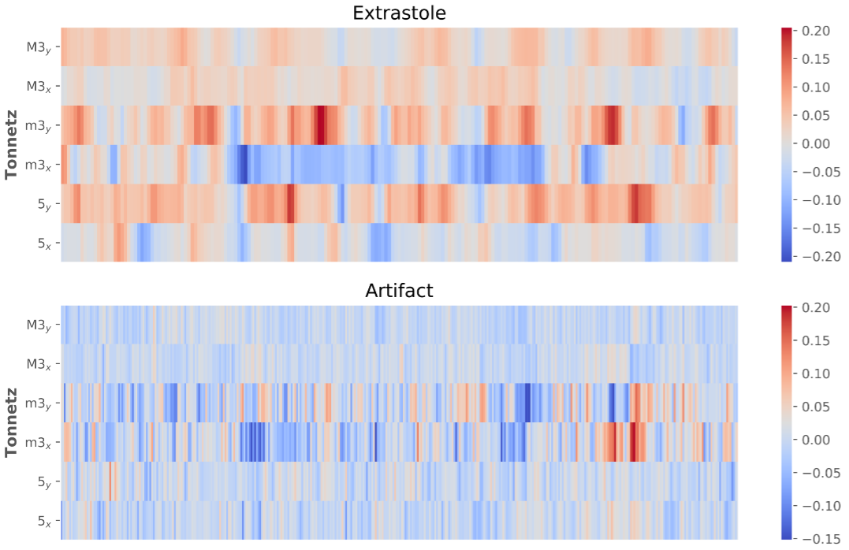
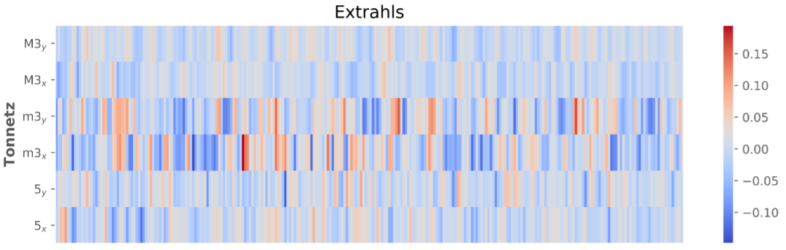
Tonal Centroids

Slide 15
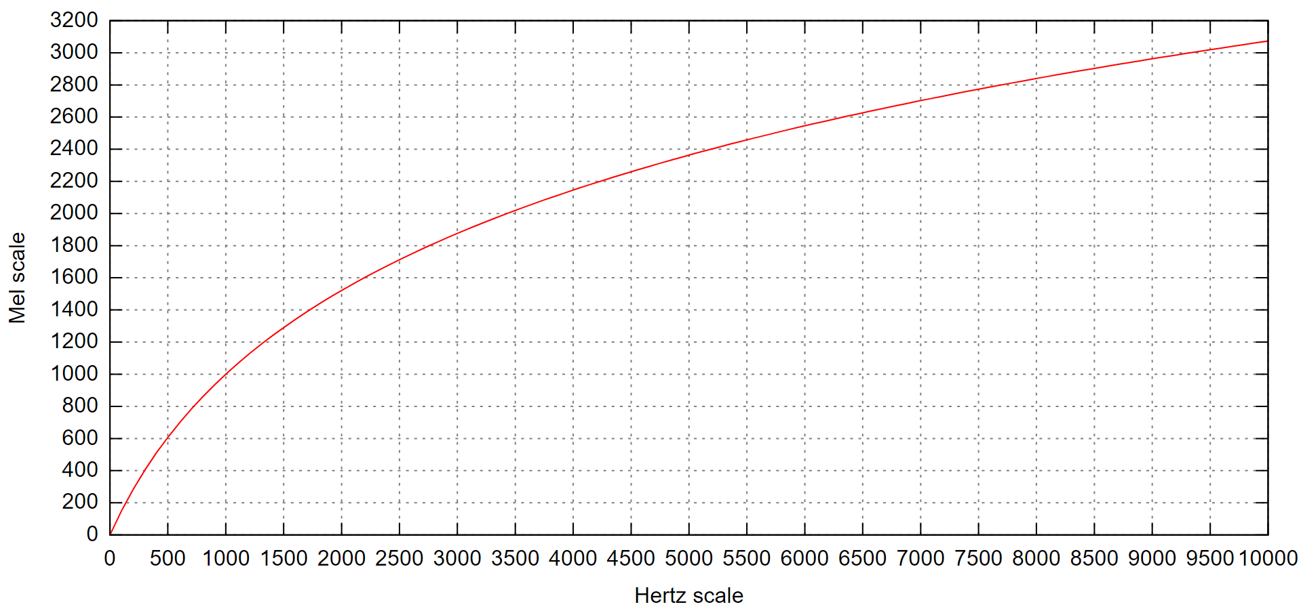
Mel scale
is a perceptual scale of pitches judged by listeners to be equal in distance from one another

Slide 16
Core Algorithm: SVM
SVMs construct a maximum margin separator—a decision boundary with the largest possible distance to example points.
SVMs creates a linear separating hyperplane.
Non linearly separable data is easily separable in the higher dimensional space.
SVMs are nonparametric method.
SVMs combine the advantages of nonparametric and parametric models: they have the flexibility to represent complex functions, but they are resistant to overfitting.

Slide 17
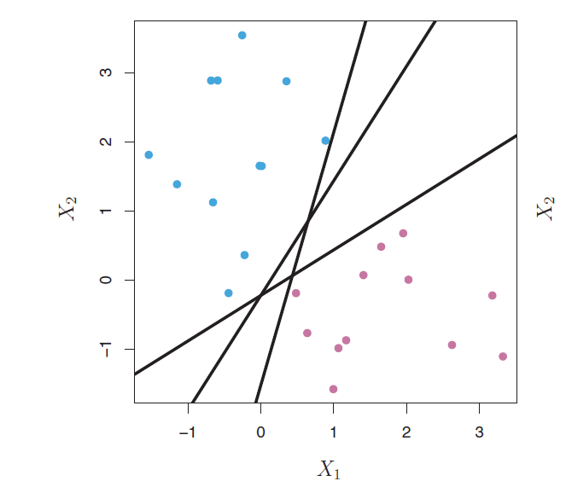
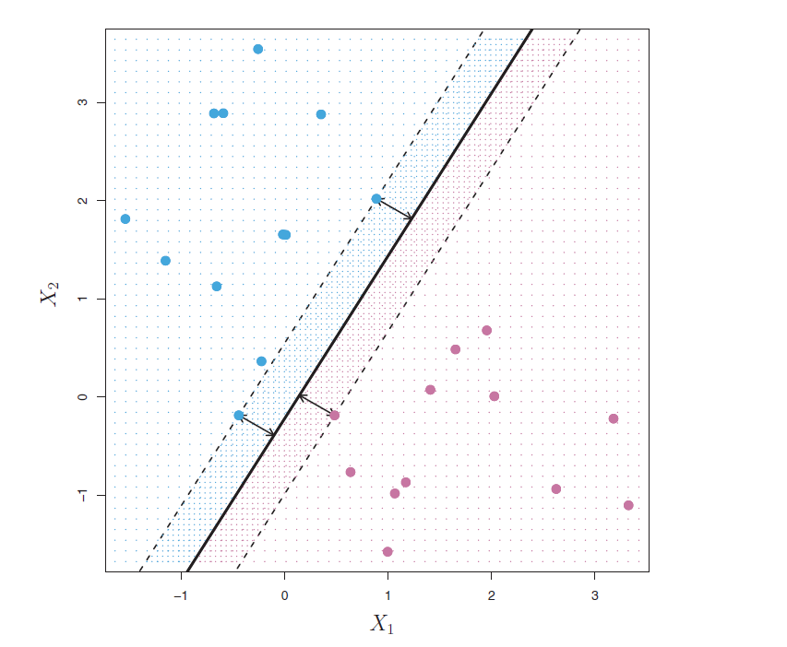
Maximal Margin Classifier
The maximal margin classifier tries to find the largest possible margin so that every observation is not only on the correct side of the hyperplane but also on the correct side of the margin.
Notes:
Support Vectors: they “support” the maximal margin hyperplane in the sense vector that if these points were moved slightly then the maximal margin hyperplane would move as well.
the maximal margin hyperplane depends directly on the support vectors, but not on the other observations a movement to any of the other observations would not affect the separating hyperplane, provided that the observation’s movement does not cause it to cross the boundary set by the margin.
The maximal margin hyperplane is extremely sensitive to a change in a single observation suggests that it may have overfit the training data.
No separating hyperplane exists, and so there is no maximal margin classifier.

Slide 18
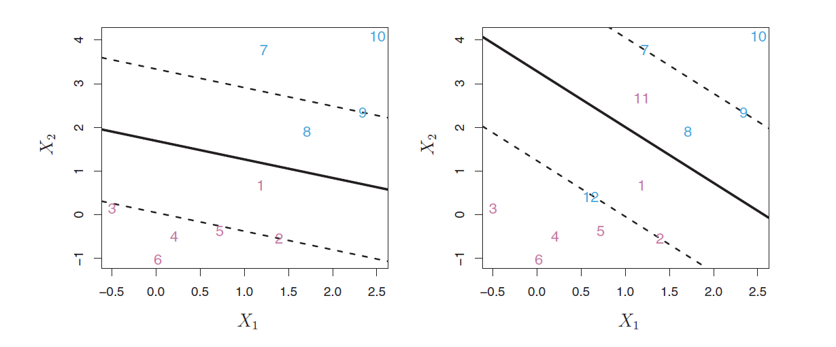
Support Vector Classifier
The support vector classifier(soft margin classifier) unlike maximal margin classifier allows some observations to be on the incorrect side of the margin, or even the incorrect side of the hyperplane.
Notes:
Extend the concept of a separating hyperplane in order to develop a hyperplane that almost separates the classes, using a so-called soft margin. The generalization of the maximal margin classifier to the non-separable case is known as the support vector classifier.
A classifier based on a hyperplane that does not perfectly separate the two classes. It could be worthwhile to misclassify a few training observations
in order to do a better job in classifying the remaining observations.

Slide 19
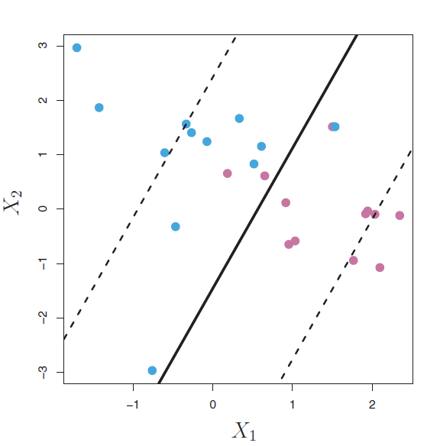
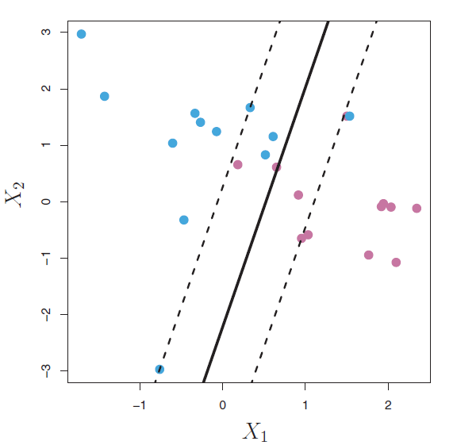
Tuning Parameter
Determines the number and severity of the violations to the margin (and to the hyperplane) that we will tolerate.
Notes:
Determines the number and severity of the violations to the margin (and to the hyperplane) that we will tolerate.
C = 0 then there is no violations to the margin will be tolerated.
For C > 0 no more than C observations can be on the wrong side of the hyperplane.
As C increases, we become more tolerant of violations to the margin, and so the margin will widen , there are many support vectors hence classifier has low variance and high bias. If C decreases, we become less tolerant of violations to the margin and so the margin narrows, less number of support vectors, hence classifier has high variance and lows bias.

Slide 20
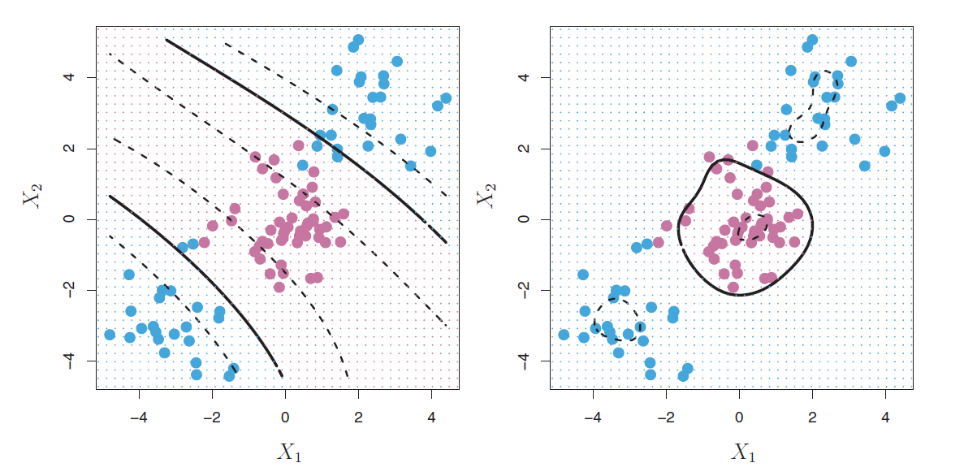
Support Vector Machines
The support vector machine (SVM) is an extension of the support vector classifier that results from enlarging the feature space in a specific way, using kernels.
A kernel is a function that quantifies the similarity of two observations.
Notes:
The support vector classifier is a natural approach for classification in the two-class setting, if the boundary between the two classes is linear. However, in practice we are sometimes faced with nonlinear class boundaries.
we consider enlarging the feature space using functions of the predictors, such as quadratic and cubic terms, in order to address this non-linearity.
In the enlarged feature space, the decision boundary is in fact linear. But in the original feature space due to the polynomial function of predictors we generally have a non-linear decision boundary.
Polynomial kernel of degree d, a kernel with d > 1, instead of the standard linear algorithm leads to a much more flexible decision boundary. It essentially amounts to fitting a support vector classifier in a higher-dimensional space involving polynomials of degree d, rather than in the original feature space.
Radial kernel: radial kernel has very local behavior, in the sense that only nearby training observations have an effect on the class label of a test observation. Outliers don’t have an effect on the predicted class labels for the radial kernels.

Slide 21
Implementation
•We have used a radial kernel with a tuning parameter of 10.
•With SVM implemented on all the features (577), we have received an accuracy of 67.52%.

Slide 22
Fine Tuning of Core Algorithm
Feature Selection using Random Forest:
We have used Boruta library to run Random Forest algorithm on our dataset.
The algorithm resulted in 88 important features, 364 unimportant features and 127 tentative features.
We have removed the unimportant attributes from the dataset manually to check the accuracy of the algorithm.
The original accuracy for SVM over all the features was 67.52%.
With the unimportant features removed, the accuracy increased to 75.21%.

Slide 23
Fine Tuning of Core Algorithm
Principal Component Analysis (PCA)
Builds new set of properties on combination of the existing attributes.
Summarizes data to remove the redundancy of related properties.
82 components selected which shows 99% of variance in the original data set.
After performing PCA on the dataset, the PCA Data was used for classification using our core algorithm, SVM.
The accuracy received was increased to 80.34%.

Slide 24
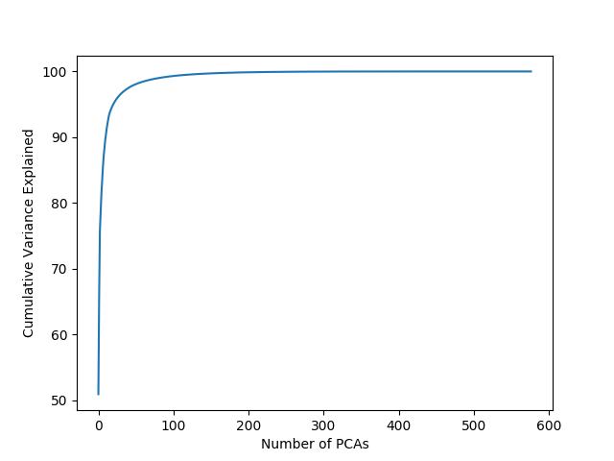
Principal Component Analysis - Plot

Slide 25
Other Algorithms
Decision Tree
A decision tree is a decision support tool that uses a tree-like graph or model of decisions and their possible consequences.
Each node represents a ‘test’ and each branch represents the outcome of the test.
We have used the decision tree algorithm on our dataset that is retrieved after performing Principal Component Analysis and received the accuracy of 61.53%.

Slide 26
Other Algorithms
Multinomial Logistic Regression
The general purpose of multinomial logistic regression model is to learn more about the relationship between several independent or predictor variables and a dependent or criterion variable.
We have used this algorithm for our dataset that resulted after Principal Component Analysis and the accuracy for this model has turned out to be 73.50%.

Slide 27
Other Algorithms
Multilayer Neural Network
Design:
2 hidden layers [160, 200]
Learning Rate: 0.01
Regularization: L2
Results
Accuracy: 74.2%

Slide 28
Comparison of Algorithms
 | Algorithms
 | Decision Tree | Logistic Regression | Neural Network | Support Vector Machine
Accuracy with PCA Data | 61.53 | 73.50 | 74.2 | 80.34

Slide 29
Model Quality
Accuracy: 80.3%
Confusion Matrix
Predicted Class | Normal | Artifact | Extrahls | Extrastole | Murmur
Normal | 71 | 0 | 0 | 10 | 5
Artifact | 1 | 7 | 0 | 0 | 0
Extrahls | 2 | 0 | 2 | 0 | 0
Extrastole | 1 | 0 | 0 | 1 | 0
Murmur | 3 | 0 | 0 | 1 | 13
precision | Recall | F1 score
0.91 | 0.83 | 0.87
1 | 0.88 | 0.93
1 | 0.50 | 0.67
0.08 | 0.50 | 0.14
0.72 | 0.76 | 0.74

Slide 30
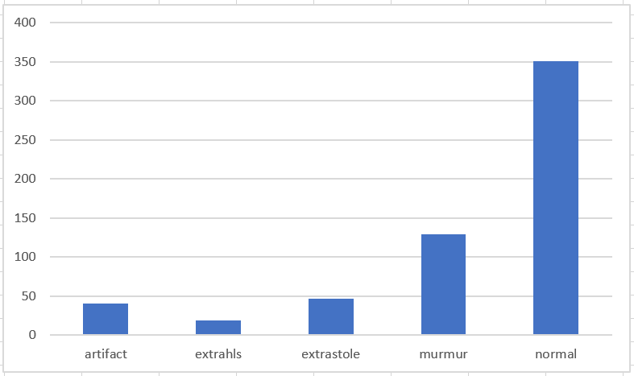
Distribution of classes

Slide 31
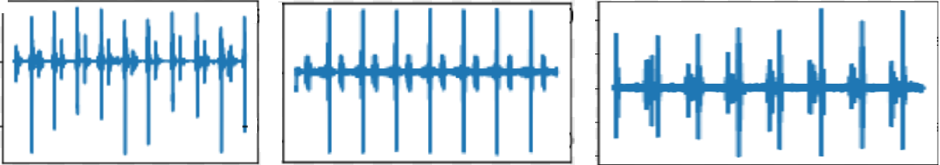
Similarities between normal, murmur, and extrahls .WAV files

Slide 32
Conclusions
With the confusion matrix for all the algorithms, we concluded that most misclassification were related to normal class. Reasons for this could be:
Normal class label has highest frequency.
Samples could belong to more than one class - audio files contain mixed heartbeat recordings.
SVM is the core algorithm. It gives us the maximum accuracy over PCA Data.
We have used Feature selection using Random Forest and PCA to fine tune the algorithm.

Slide 33
Conclusions
We have compared the performance of core algorithm with Logistic Regression, Decision tree and Multilayer Neural Network.
Trying multiple combinations of algorithms we couldn’t obtain more than 80% accuracy.
The unimportant features received with Random forest algorithm were a mix of all the attributes received after the transformation of audio files. This shows that there are no specific attribute kind which were unimportant.
Future work:
Determine which feature vectors are relevant (i.e. using group lasso)
Collect longer recordings of heartbeat audio files to distinguish the audio data better and classify them into specific category accurately.

